Slide 1
Virtual Private Cloud

Slide 2
Virtual Private Cloud
Your own private cloud on AWS
Full control of your cloud

Slide 3
Online Order Processing Application
Web
Resilient
Scaling
Security
Cost
App
Database

Slide 4


Region
AZ 1
AZ 3
AZ 2
Application should be spread across two or more availability zones

Slide 5
Network
VPC
Web
Public Subnet
App
DB
Private Subnet
AZ 1
AZ 2
AZ 3

Slide 6
High Availability
VPC
Web Web
Public Subnet
App
App
DB-P DB-S
Private Subnet
AZ 1
AZ 2
AZ 3

Slide 7
High Availability – Multi-AZ
VPC
Web
Web
Public Subnet
Public Subnet
App
App
DB-P
DB-S
Private Subnet
Private Subnet
AZ 1
AZ 2
AZ 3
No single point of entry

Slide 8
With ELB
VPC
Elastic Load Balancer (web)
Web
Public Subnet
Web
Public Subnet
Elastic Load Balancer (app)
App
DB-P
Private Subnet
App
DB-S
Private Subnet
AZ 1
AZ 2
AZ 3

Slide 9








Home Network
192.168.0.10
My router
192.168.0.1 (private)
176.32.200.140 (public)
192.168.0.11
amazon.com
205.251.242.103
192.168.0.20

Slide 10
VPC Router
Router
Web
Public Subnet
Web
Public Subnet
Main Route Table
Destination | Target
10.0.0.0/16 | local
App
DB
Private Subnet
App
DB
Private Subnet
VPC: 10.0.0.0/16

Slide 11








VPC IP
Router
Web
Private IP
Main Route Table
Public Subnet
Destination | Target
10.0.0.0/16 | local
App
Private IP
DB
Private IP
Private Subnet
VPC: 10.0.0.0/16

Slide 12








VPC Internet Gateway
Internet Gateway
Router
Public IP
Web
Private IP
Main Route Table
Public Subnet
Destination | Target
10.0.0.0/16 | local
App
Private IP
DB
Private IP
Private Subnet
VPC: 10.0.0.0/16

Slide 13
VPC Internet Gateway Route
Internet Gateway
Router
Public Route Table
Destination | Target
10.0.0.0/16 | local
0.0.0.0/0 | IGW-id
Public IP
Web
Private IP
Public Subnet
Main Route Table
App
Private IP
Destination | Target
10.0.0.0/16 | local
DB
Private IP
Private Subnet
VPC: 10.0.0.0/16

Slide 14
Firewall
Security Group
Network Access Control List (NACL)

Slide 15


Firewall
Security Group and Network ACL
Internet Gateway
HTTP
HTTPS
Router
Public IP
Web
Web
Private IP
Public Subnet
App
App
Private IP
DB
Private IP
Database
Private Subnet
VPC: 10.0.0.0/16

Slide 16
Security Group – Instance Firewall
Default Security Group
Inbound Rules
Source | Protocol | Port Range | Type
Default SG-ID | ALL | ALL | All Traffic
Instance
Outbound Rules
Security Group
Specify what traffic is
ALLOWED
Destination | Protocol | Port Range | Type
0.0.0.0/0 | ALL | ALL | All Traffic

Slide 17
Web Server Security Group
Inbound Rules
Source | Protocol | Port Range | Type
0.0.0.0/0 | TCP | 80 | HTTP
0.0.0.0/0 | TCP | 443 | HTTPS
Web Server
Outbound Rules
Security Group
Destination | Protocol | Port Range | Type
0.0.0.0/0 | ALL | ALL | All Traffic

Slide 18
Security Group is Stateful
Inbound request
Outbound response
Outbound request
Inbound response
Web Server
Web Server
Security Group
Inbound Rules
Security Group
Outbound Rules
If a request is allowed, the response for the request is automatically allowed

Slide 19
App Server Security Group
Inbound Rules
Source | Protocol | Port Range | Type
WebServerSG-ID | TCP | 80 | HTTP
WebServerSG-ID | TCP | 443 | HTTPS
App Server
Outbound Rules
Security Group
Destination | Protocol | Port Range | Type
0.0.0.0/0 | ALL | ALL | All Traffic

Slide 20
Database Server Security Group
Inbound Rules
Source | Protocol | Port Range | Type
AppServerSG-ID | TCP | 3306 | MySQL Aurora
Database Server
Outbound Rules
Security Group
Destination | Protocol | Port Range | Type
0.0.0.0/0 | ALL | ALL | All Traffic

Slide 21
Security Group
Internet Gateway
HTTP
HTTPS
Router
Web
Web
WebServerSG
App
App
AppServerSG
DB
DBServerSG
Database
VPC: 10.0.0.0/16

Slide 22
Security Group is Stateful
Inbound request
Outbound response
Outbound request
Inbound response
Web Server
Web Server
Security Group
Inbound Rules
Security Group
Outbound Rules
If a request is allowed, the response for the request is automatically allowed

Slide 23
Network Access Control List (NACL) – Subnet Firewall
Inbound
traffic
Outbound traffic
Specify what traffic is ALLOWED or
DENIED in a subnet
All instances in the subnet are automatically protected
Instance 1
Instance 2
Stateless firewall – you need to allow both inbound and outbound traffic
Subnet
NACL
Rules are evaluated in numeric order – lowest numbered rule that matches traffic decides the outcome

Slide 24
Default Network ACL
Inbound Rules
Rule # | Protocol | Port Range | Type | Source | Allow/ Deny
100 | ALL | ALL | All Traffic | 0.0.0.0/0 | ALLOW
* | ALL | ALL | All Traffic | 0.0.0.0/0 | DENY
Inbound
traffic
Outbound traffic
Instance 1
Instance 2
Outbound Rules
Rule # | Protocol | Port Range | Type | Destination | Allow/ Deny
100 | ALL | ALL | All Traffic | 0.0.0.0/0 | ALLOW
* | ALL | ALL | All Traffic | 0.0.0.0/0 | DENY
Subnet
Default NACL

Slide 25
Network ACL is tricky - Stateless
Public Subnet - Inbound Rules
HTTP HTTPS
Web
NACL
Rule # | Protocol | Port Range | Type | Source | Allow/ Deny
100 | TCP | 80 | HTTP | 0.0.0.0/0 | ALLOW
110 | TCP | 443 | HTTPs | 0.0.0.0/0 | ALLOW
* | ALL | ALL | All Traffic | 0.0.0.0/0 | DENY
Public Subnet - Outbound Rules
Rule # | Protocol | Port Range | Type | Destination | Allow/ Deny
100 | ALL | ALL | All Traffic | 0.0.0.0/0 | ALLOW
* | ALL | ALL | All Traffic | 0.0.0.0/0 | DENY
App
Database

Slide 26
Ephemeral Ports
Inbound
Ports
Client | request
 | 35000
Server
80
443
response
Port to receive response
Linux OS ephemeral port range is 32768-61000

Slide 27
Network ACL is tricky - Stateless
Public Subnet - Inbound Rules
HTTP HTTPS
Web
NACL
Rule # | Protocol | Port Range | Type | Source | Allow/ Deny
100 | TCP | 80 | HTTP | 0.0.0.0/0 | ALLOW
110 | TCP | 443 | HTTPs | 0.0.0.0/0 | ALLOW
* | ALL | ALL | All Traffic | 0.0.0.0/0 | DENY
Public Subnet - Outbound Rules
Rule # | Protocol | Port Range | Type | Destination | Allow/ Deny
100 | ALL | ALL | All Traffic | 0.0.0.0/0 | ALLOW
* | ALL | ALL | All Traffic | 0.0.0.0/0 | DENY
App
Database

Slide 28
Network ACL – Fix Allow Local Traffic
HTTP HTTPS
Public Subnet - Inbound Rules
Rule # | Protocol | Port Range | Type | Source | Allow/ Deny
90 | ALL | ALL | All Traffic | 10.0.0.0/ 16 | ALLOW
100 | TCP | 80 | HTTP | 0.0.0.0/0 | ALLOW
110 | TCP | 443 | HTTPS | 0.0.0.0/0 | ALLOW
* | ALL | ALL | All Traffic | 0.0.0.0/0 | DENY
Web
NACL
App
Database
VPC: 10.0.0.0/16

Slide 29
Network ACL - Deny
HTTP HTTPS
DENY suspicious requests
Public Subnet - Inbound Rules
Web
NACL
App
Database
Rule # | Protocol | Port Range | Type | Source | Allow/ Deny
50 | ALL | ALL | All Traffic | 123.123.0.0/16 | DENY
90 | ALL | ALL | All Traffic | 10.0.0.0/16 | ALLOW
100 | TCP | 80 | HTTP | 0.0.0.0/0 | ALLOW
110 | TCP | 443 | HTTPS | 0.0.0.0/0 | ALLOW
* | ALL | ALL | All Traffic | 0.0.0.0/0 | DENY

Slide 30
Network Access Control List (NACL) – Subnet Firewall
Inbound
traffic
Outbound traffic
Specify what traffic is ALLOWED or
DENIED in a subnet
All instances in the subnet are automatically protected
Instance 1
Instance 2
Stateless firewall – you need to allow both inbound and outbound traffic
Subnet
NACL
Rules are evaluated in numeric order – lowest numbered rule that matches traffic decides the outcome

Slide 31
Private, Public and Elastic IP

Slide 32
VPC CIDR
IPv4 and IPv6 Traffic are routed separately
VPC
Configure
Route table
Security Group
Network ACL
10.0.0.0/16 (IPv4)
2600:1f16:e3f:7000::/56 (IPv6)
Private IPv4 CIDR
10.0.0.0 - 10.255.255.255
172.16.0.0 - 172.31.255.255
(10.0.0.0/8 prefix)
(172.16.0.0/12 prefix)
192.168.0.0 - 192.168.255.255 (192.168.0.0/16 prefix)

Slide 33



Private IP
Server
Private IP automatically assigned from subnet CIDR block
10.0.1.20
Subnet 10.0.1.0/24
VPC: 10.0.0.0/16
(IPv4)

Slide 34


Elastic Network Interface (ENI)
IP address is assigned to the
primary network interface eth0
Server
10.0.1.20
Private DNS Hostname
Primary network interface and private IP address stays with the instance until instance is terminated
Subnet: 10.0.1.0/24
VPC: 10.0.0.0/16
(IPv4)

Slide 35
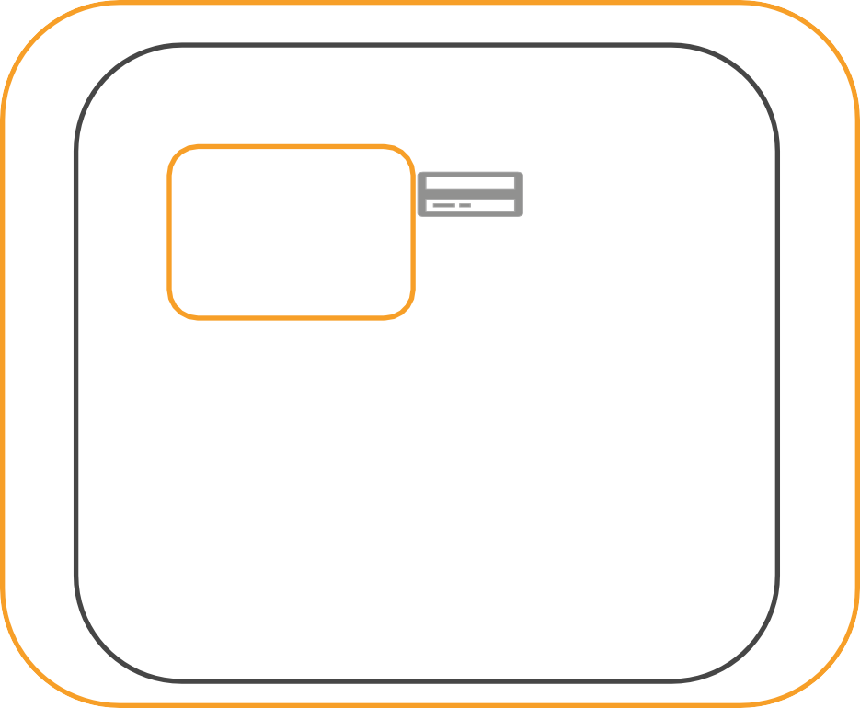






Multiple Elastic Network Interfaces (ENI)
Multiple network interfaces can
be attached to an instance
Secondary ENI can be detached and attached to another instance
Network traffic to that IP address is redirected to the new instance
Server 1
10.0.1.20
10.0.1.30
10.0.1.21
Server 2
Subnet: 10.0.1.0/24 VPC: 10.0.0.0/16 (IPv4)
10.0.1.30

Slide 36

Public IP
Public IP required to send or receive request from the internet
3.15.22.48
Server 1
Public IP Assignment:
Specify at the time of launching the instance
Subnet setting to auto-
assign public IP
10.0.1.20
Subnet: 10.0.1.0/24
Assigned from Amazon’s
Public IP pool
VPC: 10.0.0.0/16
(IPv4)

Slide 37

Public IP – Instance Start/Stop/Terminate
Stop or Terminate instance
Public IP is released back to pool
31.91.51.52.22.34.85
Server 1
10.0.1.20
Restart a stopped instance
New Public IP is assigned
Public IP will change if you stop
and restart an instance
Subnet: 10.0.1.0/24
VPC: 10.0.0.0/16
(IPv4)

Slide 38





Elastic IP
Elastic IP is static-public IP address
3.139.10.48
Server 1
Assign to any instance
10.0.1.20
Stays attached to stopped instance
Subnet: 10.0.1.0/24
Limit of 5 Elastic IP per account per region
VPC: 10.0.0.0/16
(IPv4)

Slide 39






Elastic IP – Move to a different instance
3.139.10.48
3.139.10.48
Server 1
Server 2
10.0.1.20
10.0.5.54
Subnet: 10.0.1.0/24
Subnet: 10.0.5.0/24
Detach and attach to a different instance in the same region in your account
Redirect traffic to the new instance
Elastic IP remains allocated to your account until you release it

Slide 40
Private, Public, Elastic
Private – Each instance is assigned a Private IP. Stays for the life of the instance
Public – Optional. Enabled when launching the instance. Required to send or receive traffic from the internet
Elastic – Optional. Persistent/Static IP address assigned to your account/region. Required to send or receive traffic from the internet. You can reassign to any instance in the region

Slide 41
Integrating with other AWS Services
Internet
Gateway Endpoint
Interface Endpoint

Slide 42
How to integrate with other AWS services?
Internet Gateway Router
AWS Services
S3
DynamoDB
Web
Public Subnet
Web
Public Subnet
SQS
Kinesis
App
DB
Private Subnet
App
DB
Private Subnet
RDS
AI
VPC: 10.0.0.0/16

Slide 43

Option 1: Public instances use the internet
Internet Gateway
S3
Web
Public Subnet
Instances in public subnet can make outbound calls to the internet
But, what about the instances in private subnet? How do they interact with other AWS services?
App
DB
Private Subnet
VPC: 10.0.0.0/16

Slide 44
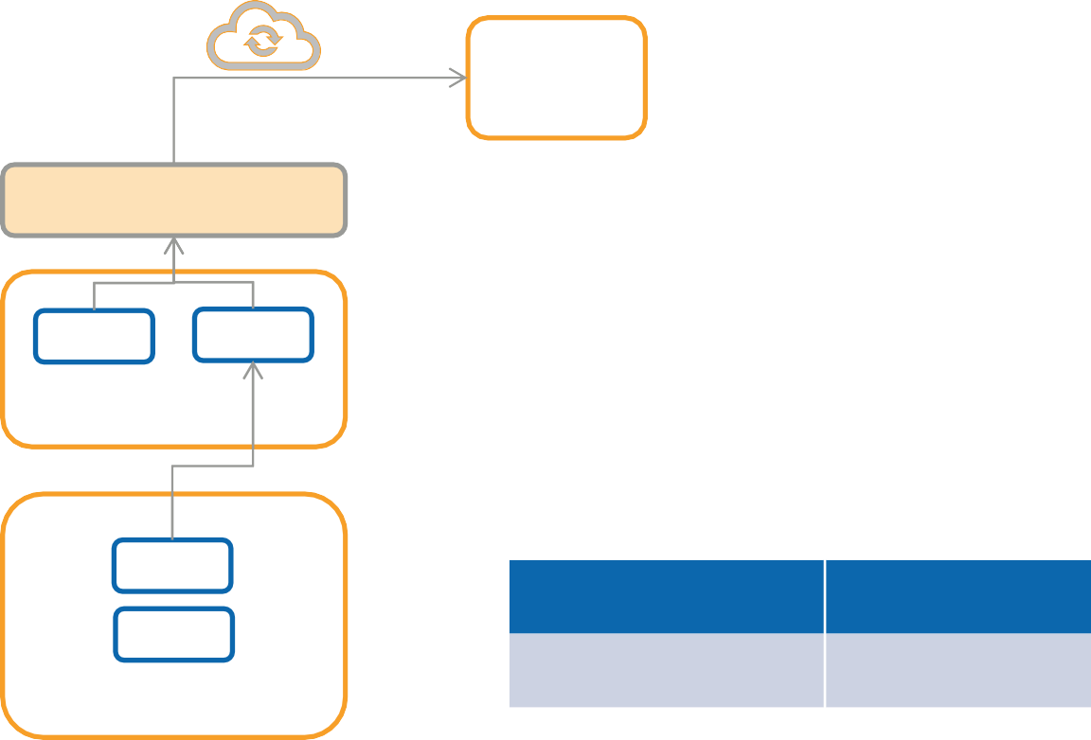
Option 1: Private instances use the internet with NAT
S3
Internet Gateway
Public Route Table
Destination | Target
10.0.0.0/16 | local
0.0.0.0/0 | IGW-id
Web NAT
Public Subnet
Private Route Table
App
DB
Private Subnet
Destination | Target
10.0.0.0/16 | local
VPC: 10.0.0.0/16

Slide 45
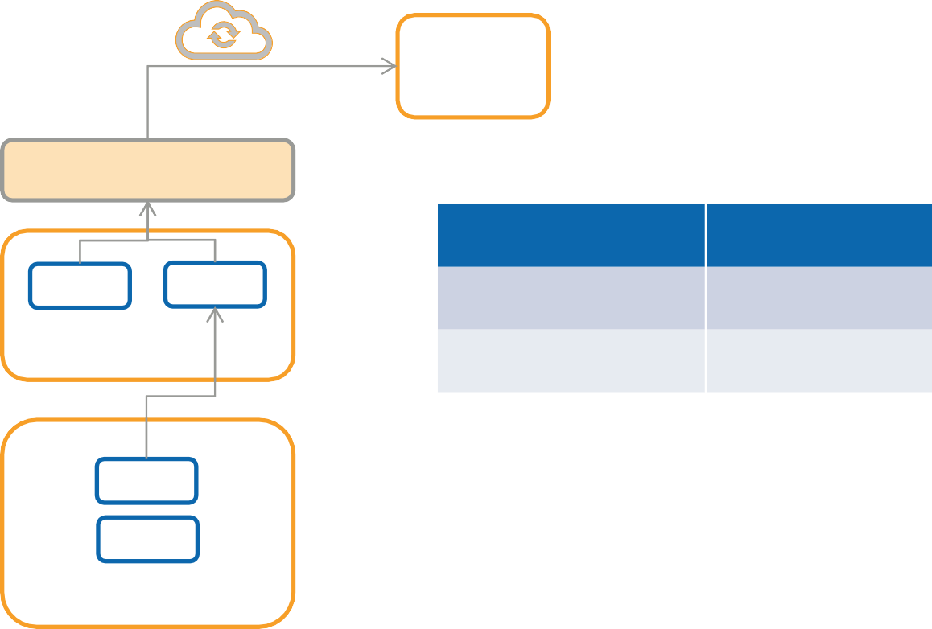
Option 1: Private instances use the internet with NAT
S3
Internet Gateway
Public Route Table
Destination | Target
10.0.0.0/16 | local
0.0.0.0/0 | IGW-id
Web NAT
Public Subnet
Private Route Table (include path to NAT)
App
DB
Private Subnet
Destination | Target
10.0.0.0/16 | Local
0.0.0.0/0 | NAT-GW-id
VPC: 10.0.0.0/16

Slide 46
NAT
NAT Gateway is a managed
service
Automatically scales
Elastic IP required
Deployed in Public Subnet in specific AZ
High Availability – Deploy one
per AZ
Blocks unsolicited inbound requests
NAT Instance – single server NAT. You handle HA, Scalability
NAT
Gateway 1
NAT
Gateway 2
Public Subnet – AZ1
Public Subnet – AZ 2
App
DB
Private Subnet – AZ1
App
DB
Private Subnet – AZ2

Slide 47



Why not talk directly to AWS services?
AWS Cloud
AWS Services
E N D
Dynamo
DB
S3
Our App VPC
P O I N T
SQS
Kinesis
RDS
AI
With endpoints, you can privately talk to AWS services (without using the internet)

Slide 48
Endpoint Types
Gateway Endpoint - S3, DynamoDB
Interface Endpoint – All newer services use interface endpoint

Slide 49

Gateway Endpoint
S3
Public Route Table
Destination | Target
10.0.0.0/16 | local
0.0.0.0/0 | IGW-id
Pl-id | VPCE-id
Other Regions
Internet Gateway
NAT Web
Public Subnet
E N D
P O I N T
S3
Private Route Table
App
DB
Private Subnet
Same Region
Destination | Target
10.0.0.0/16 | Local
0.0.0.0/0 | NAT-GW-id
Pl-id | VPCE-id
VPC: 10.0.0.0/16

Slide 50
Gateway Endpoint
With endpoint, you can access S3 and DynamoDB using Private IP address
Endpoint is regional - Used for S3 and DynamoDB in the same region
For other regions, use internet gateway +NAT

Slide 51
Endpoint Types
Gateway Endpoint - S3, DynamoDB
Interface Endpoint – All newer services use interface endpoint

Slide 52

Interface Endpoint
SQS
Other Regions
Internet Gateway
No need to update route table to use endpoint – Private IP
NAT Web
Public Subnet
AZ1
NAT
Web
Queue Name:
sqs.us-east-1.amazonaws.com
Public Subnet
AZ2
SQS
With Private DNS HostName option, Service DNS name is automatically mapped to Endpoint IP address
App
DB
End Point
App
DB
End
Point
Same Region
Private Subnet
Private Subnet
VPC: 10.0.0.0/16

Slide 53
Availability Zone ID
us-east-2c
us-east-2b
us-east-2a
Availability
Zone
Account 1
Physical Location
use2-az1
use2-az2
use2-az3
Availability
Zone ID
us-east-2b
us-east-2a
us-east-2c
Availability Zone
Account 2
Interface endpoint and service could end-up in different AZs. To prevent this scenario, check the Availability Zone ID

Slide 54
Interface Endpoint Summary
Interface endpoints are also known as PrivateLink
Privately interact with many AWS services (same-region)
Interface endpoint creates a network interface with private IP (easy to remember)
Flexibility to expose your service to other customers

Slide 55
Summary – Integrating with AWS services
Useful for both cross-region, same-region access Public instances – Internet Gateway
Private instances – NAT + Internet Gateway
Internet
Gateway Endpoint Interface Endpoint
Private connectivity to S3, DynamoDB in the same region
For other regions, use the internet
Private connectivity to many AWS services in the
same region
For HA, create an interface endpoint in each AZ For other regions, use the internet

Slide 56
Log in to instance
Directly login (Public Instances)
Bastion Host
Systems Manager – Session Manager

Slide 57
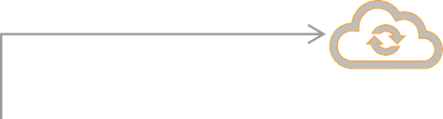

How to log in to public instance?
Internet Gateway
Web Public Subnet
Public Instance Security Group Inbound Rules
Web
Public Subnet
Source | Protocol | Port Range | Type
0.0.0.0/0 | TCP | 22 | SSH
99.29.0.0/16 | TCP | 22 | SSH
99.29.0.0/16 | TCP | 3389 | RDP
App
DB
Private Subnet
App
DB
Private Subnet
VPC: 10.0.0.0/16

Slide 58
How to Log in to Private instance?
Bastion Host
Systems Manager – Session Manager

Slide 59
How to log in to private instance with Bastion Host
Internet Gateway
BH Web Public Subnet
BH Web
Public Subnet
Bastion Host – Good use case for Elastic IP
For HA, reassign Elastic IP to new Bastion
Host instance
App
DB
Private Subnet
App
DB
Private Subnet
Client can use existing Elastic IP to connect to new instance
VPC: 10.0.0.0/16

Slide 60
Security Group
Bastion Host Security Group - Inbound Rules
Source | Protocol | Port Range | Type
99.29.0.0/16 | TCP | 22 | SSH
99.29.0.0/16 | TCP | 3389 | RDP
Bastion Host
Security Group
Web-App-DB Security Group - Inbound Rules
Source | Protocol | Port Range | Type
BastionHost-SG-id | TCP | 22 | SSH
BastionHost-SG-id | TCP | 3389 | RDP
Instances (web-app-db)
Security Group

Slide 61
Bastion Host Drawback
EXTRA SERVERS TO MANAGE
MANAGE SERVER LOGIN CERTIFICATES AND CREDENTIALS

Slide 62
Systems Manager
Automated patching of servers
Automation of routine administrative tasks
Session Manager – interactive remote shell for Linux and Windows, macOS
Agent required – AWS preinstalls in many instances

Slide 63

Session Manager - Login
AWS
Systems Manager Service
Internet Gateway
IAM
Credentials for login
Web Public Subnet
Web
Public Subnet
Browser and CLI remote shell
End Point
App
DB
End Point
App
DB
Private Subnet
Private Subnet
VPC: 10.0.0.0/16

Slide 64
Systems Manager – Session Manager
Simpler and Safer when compared to Bastion Host
Grant login access for IAM credentials Close SSH and RDP ports in Security Group

Slide 65


Login - Summary
Public instances – directly connect to the instance
Bastion Host – requires additional servers
Session Manager (Systems Manager Service) – more secure

Slide 66
Integrating with other applications
Internet
Peering connection
Transit Gateway

Slide 67
Application integration
Special offers
Product Promotion Service
Marketing VPC:
172.31.0.0/16
Online Marketplace App
VPC: 10.0.0.0/16

Slide 68

Application integration over internet
Product Promotion Service
Online
Marketplace App
Marketing VPC: 172.31.0.0/16
VPC: 10.0.0.0/16
But why can’t these two applications talk directly using AWS network?

Slide 69
VPC Peering Connection
P E E R I N G
P E E R I N G
Product Promotion Service
Online Marketplace App
VPC: 10.0.0.0/16
VPC: 172.31.0.0/16
Connect VPCs into single logical network with Peering Connection
Communicate using Private IP
AWS managed – no single point of failure
CIDR block must not overlap

Slide 70
VPC Peering Connection – Route Table
P E E R I N G
P E E R I N G
Product Promotion Service
Online Marketplace App
VPC: 10.0.0.0/16
VPC: 172.31.0.0/16
Destination | Target
10.0.0.0/16 | local
172.31.0.0/16 | PCX-id
Destination | Target
172.31.0.0/16 | local
10.0.0.0/16 | PCX-id

Slide 71



VPC Peering Options
Region 1 VPC: 10.0.0.0/16 | P
 | E
 | E
 | R
 | I
 | N
 | G
P | Region 1 VPC: 172.31.0.0/16
E
E
R
I
N
G
P | Region 2 VPC: 10.1.0.0/16
E
E
R
I
N
G
Do you agree to this union?
P | Different Account VPC: 10.2.0.0/16
E
E
R
I
N
G

Slide 72

VPC Peering
Bi-directional
Not-Transitive
Online App VPC:10.0.0.0/16 | P
 | E
 | E
 | R
 | I
 | N
 | G
P | Marketing VPC: 172.31.0.0/16 | P
E |  | E
E |  | E
R |  | R
I |  | I
N |  | N
G |  | G
P | HR VPC:10.1.0.0/16
E
E
R
I
N
G

Slide 73
VPC Peering Issues
A
A
E
B
D
B
C
D
C
Fully connected mesh configuration requires several VPC Peering connections

Slide 74

Transit Gateway
Cloud router - Central networking hub
Connect VPCs to Transit Gateway once
Route table to control which VPCs can talk to each other

Slide 75
Transit Gateway
VPC A
VPC B
VPC C |  |  | TG
VPC D
VPC E
One connection from VPC to TG
TG Route table to control flow of traffic

Slide 76
Transit Gateway Peering – Cross Region
VPC A
VPC X
Peering
VPC B
TG 1
TG 2
VPC Y
VPC C
VPC Z
Region 1
Region 2

Slide 77
Enabling third-parties to call our App
Internet
Endpoint

Slide 78
Application integration
Sellers
Sellers
Sellers
Online
Marketplace App

Slide 79
Access using the Internet
Internet Gateway
Third party sellers call the API using the load balancer URL
Elastic Load Balancer
Web Web Web Web
Public Subnet Public Subnet
App DB Private Subnet
App DB Private Subnet
VPC: 10.0.0.0/16

Slide 80
Application integration inside AWS
Third party sellers are in AWS cloud
Online
Sellers in AWS
Marketplace App
VPC: 10.0.0.0/16
VPC: 172.31.0.0/16

Slide 81
Why not Peering Connection or TG?
VPCs are not part of the same enterprise
Connecting third-party VPCs with your VPC is a security risk
Privately share only the App

Slide 82


Endpoints (recap)
AWS Cloud
AWS Services
E N D
Dynamo DB
S3
VPC
P O I N T
SQS
Kinesis
RDS
AI
With endpoints, you can privately talk to AWS services (without using the internet)

Slide 83
Endpoint Types (recap)
Gateway Endpoint - S3, DynamoDB
Interface Endpoint – All newer services use interface endpoint
Privately share your application using Interface Endpoints

Slide 84


Access using the Endpoint (PrivateLink)
Privately share your application using
Interface Endpoints
Internet Gateway
Network Load Balancer – Private Link
Web Web Web Web
Public Subnet Public Subnet
E N D
P O I N T
Sellers in AWS
App DB Private Subnet
VPC: 172.31.0.0/16
App DB Private Subnet
VPC: 10.0.0.0/16

Slide 85
Hybrid Infrastructure
On-premises to AWS Cloud connectivity

Slide 86

Hybrid Infrastructure
AWS Cloud
On-premises Data Center
How to provide secure access to the cloud?

Slide 87



Internet
AWS Cloud
P U B L I C
P U B L I C
On-premises Data Center
Both on-premises and cloud needs Public IP Internet performance may not be consistent

Slide 88


VPN over Internet
V P N
AWS Cloud
V P N
V P N
On-premises Data Center
VPN provides IPSec encrypted connection
Cloud is an extension of your datacenter – access using private IP Internet performance may not be consistent

Slide 89


Direct Connect
AWS Cloud
D
X
D
X
On-premises
Data Center
Bypass internet with a dedicated link between on-premises and AWS Cloud is an extension of your datacenter – access using private IP Consistent network performance and throughput
Complex setup

Slide 90
VPN Connectivity Options
AWS Cloud | V P N | Site-to-Site | V P N | On-premises Data Center
Branch
V P N
Cloud Hub
AWS Cloud
V P N
V
P N
Branch
Inter-connect Branch offices
V
P
N
Branch

Slide 91




VPN Connectivity
V P N
Client VPN
AWS Cloud
V P N
V P N
Remote access
Access for employees working remotely

Slide 92
VPN Site-to-Site
VPC 10.0.0.0/16 | V G W |  | C G W | On-premises 172.31.0.0/16
Attach Virtual Private Gateway (VGW) to your VPC
Customer Gateway – your existing VPN hardware or software

Slide 93
VPN Site-to-Site (HA-AWS)
VPC 10.0.0.0/16
V G W
C G W
On-premises
172.31.0.0/16
AZ 1
AZ 2
AWS side, a VPN Connection consists of two tunnels each ending in different Azs
Customer Gateway is a single device and single point of failure
Handles AZ failure

Slide 94
VPN Site-to-Site (HA-AWS-OnPrem)
C G W
On-premises 172.31.0.0/16
C G W
VPC 10.0.0.0/16
V G W
AZ 1
AZ 2
Two Customer Gateway devices preferably in different data centers Two VPN connection from the same VGW but to different CGWs On-premises Connectivity is configured at VPC level

Slide 95
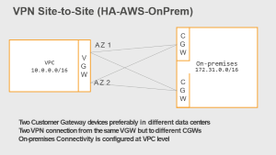
Multiple VPCs – Lots of connections
VPC A
10.0.0.0/16
V G W
VPC B 10.1.0.0/16 | V G W |  | C G W | On-premises 172.31.0.0/16
VPC C 10.0.0.0/16
V G W

Slide 96
VPN using Transit Gateway
C G W
On-premises 172.31.0.0/16
C G W
VPC A
VPC B
TGW
VPC C
Use Transit Gateway to terminate VPN Connection Share the same VPN connection with multiple VPCs

Slide 97
Cloud Hub – Multi-Site VPN
Branch
V P N
Cloud Hub
AWS Cloud
V P N
V
P N
Branch
Inter-connect Branch offices
V
P N
Branch
For multi-site VPN, we can use Transit Gateway or Virtual Private
Gateway

Slide 98
Client VPN
V P N
Client VPN
AWS Client VPN |  |  |  | V P N
 | VPC
V P N
Remote access
Access for employees working remotely using AWS Client VPN or Third-party VPN Software

Slide 99
VPN Options
Site-to-Site – Connect your data center to AWS
Cloud Hub – Interconnect your branch offices
Client VPN – Remote access to AWS from any location

Slide 100
Direct Connect
AWS Cloud
D
X
On-premises
Data Center
D
X
Bypass internet with a dedicated link between on-premises and AWS Cloud is an extension of your datacenter – access using private IP Consistent network performance and throughput
Complex setup

Slide 101

Direct Connect Setup
Direct Connect Location 1
DX-2
AWS Cloud
Direct Connect Location 2
On-premises Data Center
DX
Direct Connect Location ..n
AWS has 100+ Direct Connect locations worldwide. Choose the one closest to your data center.
Access resources in any of the AWS regions
For Critical workloads, use two Direct Connect locations (location or device failure)

Slide 102
Direct Connect with Virtual Private Gateway
VPC 10.0.0.0/16 | V G W |  | D X | On-premises 172.31.0.0/16
Attach Virtual Private Gateway (VGW) to your VPC
VGW does not support multiple-VPCs, so this option is not particularly useful

Slide 103
Direct Connect with Direct Connect Gateway
VPC A 10.0.0.0/16
Region 1
D G W
D X
On-premises
172.31.0.0/16
VPC B 10.0.0.0/16
VPC C 10.0.0.0/16
Region 2
Direct Connect Gateway (DGW) supports multiple VPCs across different
regions

Slide 104
Direct Connect sharing with Transit Gateway
VPC A
Region 1
D G W
D X
On-premises
172.31.0.0/16
VPC B
TGW 1
VPC C
TGW 2
Region 2
Share Direct Connect Link with other VPCs using Transit Gateway

Slide 105
Direct Connect to access other AWS Services
VPCs
TGW 1
D G W
D X
On-premises
172.31.0.0/16
AWS Services
Access AWS services from On-premises using Direct Connect with Public Virtual Interface
Traffic from on-premises is routed through DX and uses AWS Global network to access required service

Slide 106
VPN over Direct Connect
You can also setup a VPN connection inside Direct Connect
Encrypted channel with consistent network performance

Slide 107
VPN as Backup for Direct Connect
If you use only one Direct Connect location, to handle device and location failures, you can setup a backup VPN connection over the internet

Slide 108


Direct Connect Summary
DX - Physical Connection between your data center and AWS
Consistent network performance and throughput
For HA, use multiple DX Locations or use a backup VPN over the internet

Slide 109
VPC Components Summary
Component | Description
VPC | Isolated virtual network in AWS cloud
Subnet | Isolated segment of your VPC
Internet Gateway | VPC side of connection to internet
NAT Gateway | AWS managed Network Address Translation Service to make outbound internet connection from your private subnet (IPv4)
NAT Instance | Customer managed NAT (IPv4)
Egress-only Internet Gateway | IPv6 outbound internet access

Slide 110
VPC Components
Component | Description
Router | Routes traffic inside VPC
Security Group | Instance level stateful firewall. Supports only Allow rules
Network Access Control List | ACLs are subnet level stateless firewall. Supports Allow and Deny rules

Slide 111
VPC Components – Hybrid Architecture
Component | Description
Internet | Suitable for Internet accessible resources
Hardware VPN Connection | Secure connection between your datacenter and VPC (over internet or over direct connect)
Virtual Private Gateway | AWS side of VPN connection
Customer Gateway | Customer side of VPN connection
Direct Connect | Dedicated Private connectivity between customer on-premises network/Offices to AWS
Transit Gateway | Interconnect VPCs, Share Direct Connect and VPN link among VPCs

Slide 112
VPC Components – Connecting VPCs
Component | Description
Peering Connection | Connect two VPCs and access resources with private IP address
Gateway Endpoint | Access AWS resources like S3, DynamoDB without using NAT or Internet Gateway. Limit access to resources from specific VPCs
Interface Endpoint | New Capability powered by AWS Private Link. Setup private connections to AWS Supported Services, Services hosted by AWS Partners, Customers and Marketplace partners

